Slide 1
Capstone Project – The Battle of Neighborhoods

Slide 2
Introduction
This Project aim to create an analysis of features for a people migrating to Delhi to search a best neighborhood as a comparative analysis between neighborhoods.

Slide 3
Purpose
To help people in exploring better facilities around their neighborhood.
help people making smart choice in selecting their neighborhood in Delhi

Slide 4
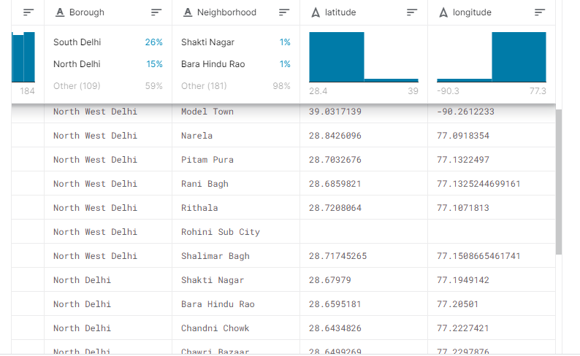
Data Selection
Data Link :https://www.kaggle.com/shaswatd673/delhi-neighborhood-data
we will use delhi Dataset consisting of neighborhoods,latitude and longitude.

Slide 5
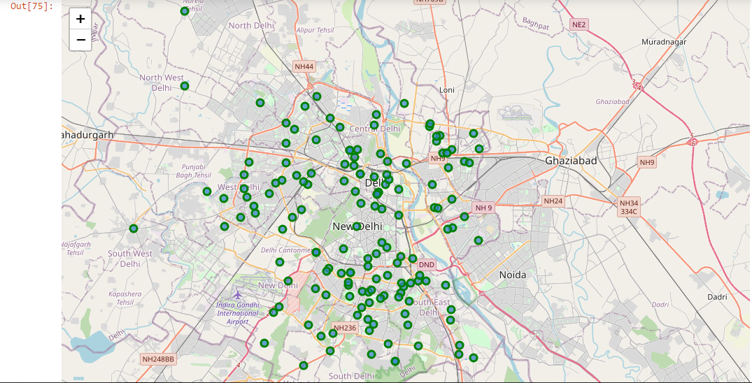
Map of delhi

Slide 6
Results Section

Slide 7
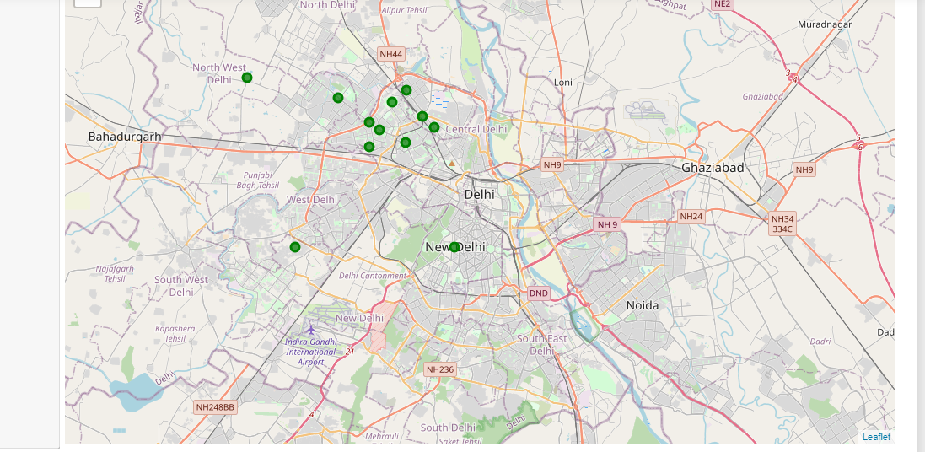
Map of Clusters in Delhi

Slide 8
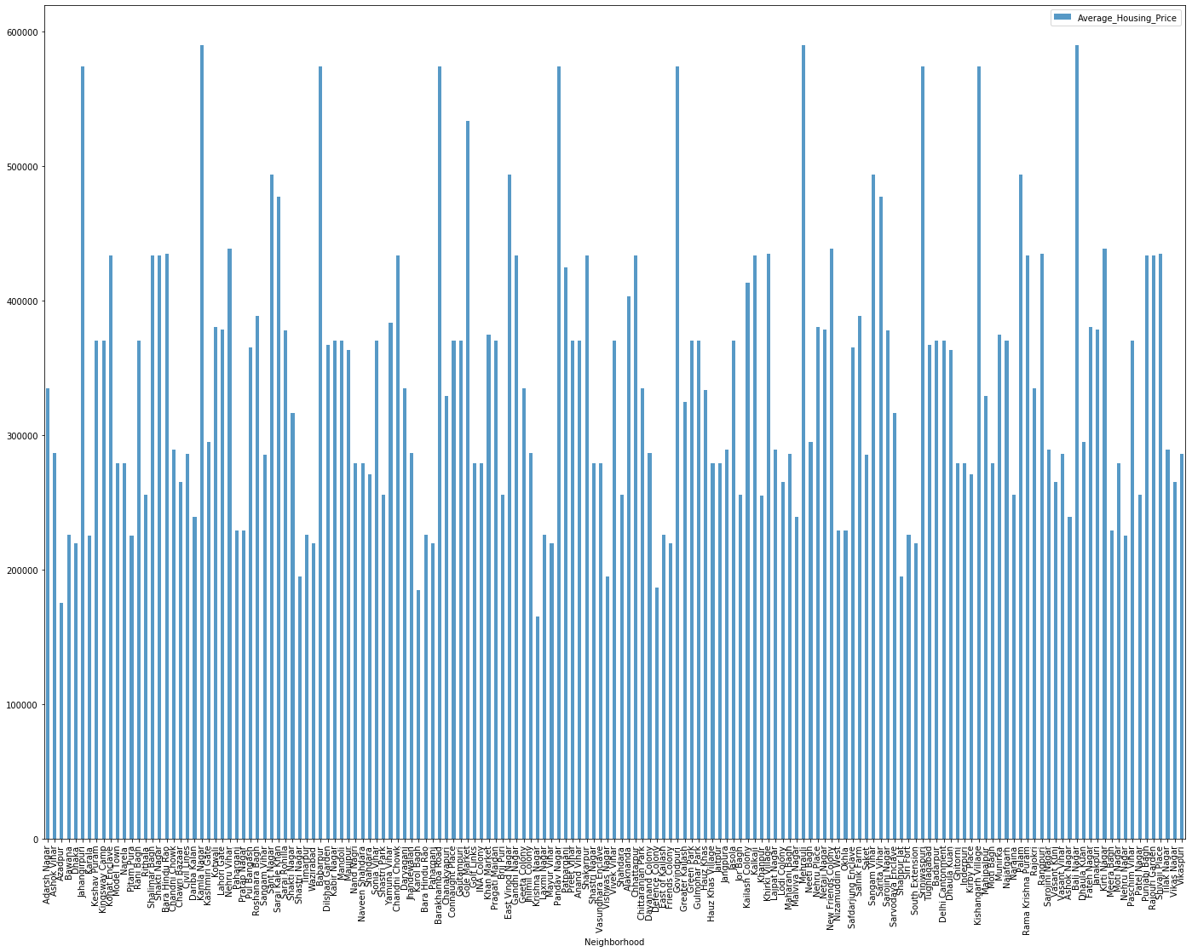
Average Housing Price by Clusters in Delhi

Slide 9
Conclusion
In this project, using k-means cluster algorithm I separated the neighborhood into 10(Ten) different clusters and for 163 different lattitude and logitude from dataset, which have very-similar neighborhoods around them. Using the charts above results presented to a particular neighborhood based on average house prices have been made.
This Capstone project can be continued for making it more precise in terms to find best house in Delhi. Best means on the basis of all required things(daily needs or things we need to live a better life) around and also in terms of cost effective.

